Slide 1
Simulating Liquid Crystals
Kit Gallagher
Supervisors: Prof Erika Eiser, Mr Jiaming Yu

Slide 2
Introduction
Introduction
Liquid Crystals
Phase Transitions
Order Parameters
DNA as a Liquid Crystal
Methods
Rigid Rod Simulations
Nunchuck Simulations
Conclusions

Slide 3
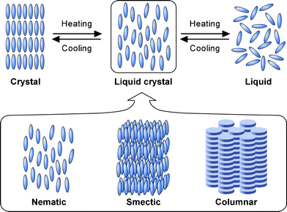
Liquid Crystals
Figure 1: Representation of the three liquid crystal phase classes, reproduced from Kato et al. [1] with permission. Note the distinct layers in the smectic and columnar phases, and the different class of molecule in the columnar phase.
[1] T. Kato, Y. Hirai, S. Nakaso, and M. Moriyama, Liquid-Crystalline Physical Gels, Chem. Soc. Rev. 36, 1857 (2007).

Slide 4
Phase Transitions
Lyotropic
Induced by changes in concentration
Entropically Driven Occurring in the absence of attractive intermolecular forces

Slide 5
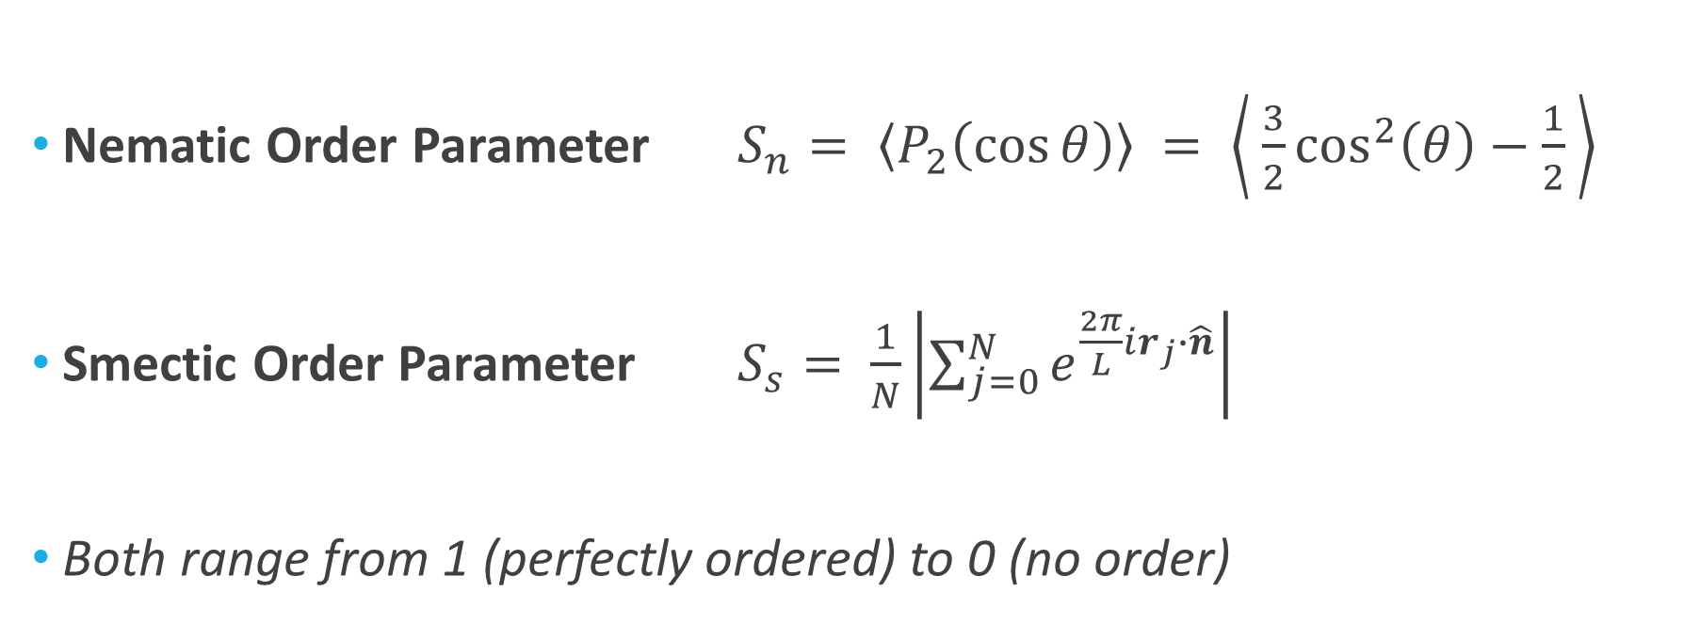
Order Parameters
Nematic Order Parameter $S_{n}= \left\langle P_{2}\left(\cos{θ}\right)\right\rangle = \left\langle \frac{3}{2}\cos^{2}\left(θ\right)−\frac{1}{2} \right\rangle$
Smectic Order Parameter $S_{s}= \frac{1}{N}\left|\sum_{j=0}^{N}{e^{\frac{2π}{L}ir_{j}∙\hat{n}}}\right|$
Both range from 1 (perfectly ordered) to 0 (no order)

Slide 6
DNA as a Liquid Crystal
insert cool picture (Figure 2) of applications following chat with Erika

Slide 7
Methods
Introduction
Methods
Nunchuck Molecules
Simulation Structure
Rigid Rod Simulations
Nunchuck Simulations
Conclusions

Slide 8
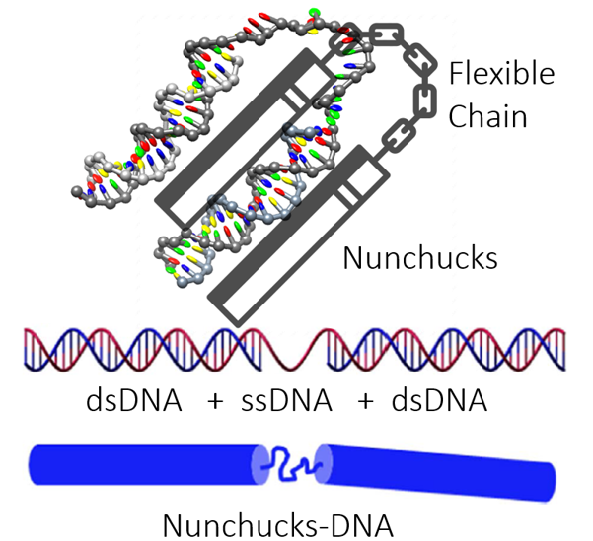
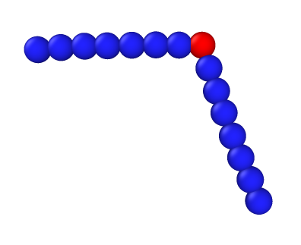
Nunchuck Molecules
Figure 4 (right): The implementation within LAMMPS, with the central red sphere representing the ss-DNA
θ
Figure 3 (left): Depiction of the analogy between the DNA mesogen and the nunchucks. Figure created by Jiaming Yu (Eiser Group, Cambridge).

Slide 9
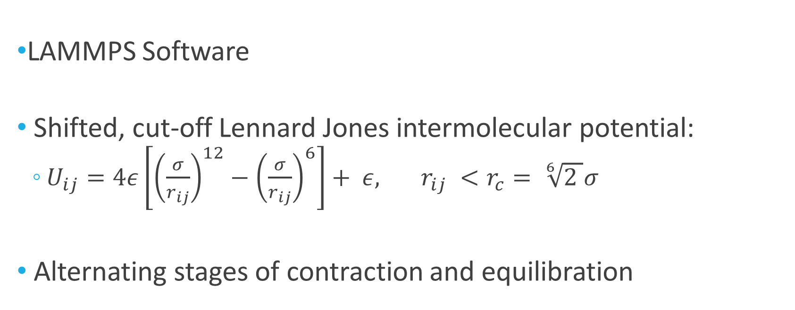
Simulation Structure
LAMMPS Software
Shifted, cut-off Lennard Jones intermolecular potential:
$U_{ij}=4ε\left[{\left(\frac{σ}{r_{ij}}\right)}^{12}−{\left(\frac{σ}{r_{ij}}\right)}^{6}\right]+ ε, r_{ij} <r_{c}= \sqrt[6]{2 }σ$
Alternating stages of contraction and equilibration

Slide 10
Rigid Rod Simulations
Introduction
Methods
Rigid Rod Simulations
Nematic Transition
Smectic Transition
Nunchuck Simulations
Conclusions

Slide 11
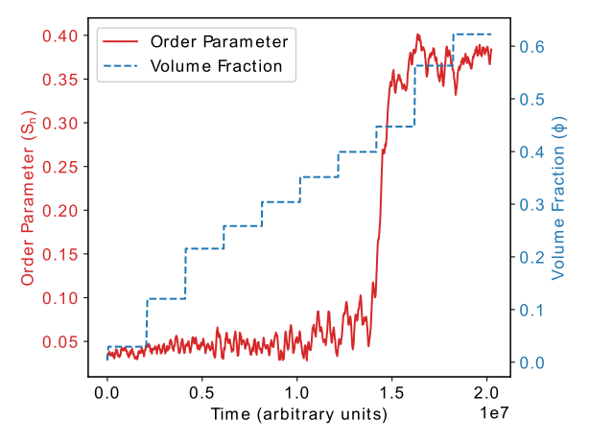
Nematic Phase Transition
Figure 5: The evolution of the volume fraction (φ) and the nematic order parameter (S_{n}) over the timescale of the simulation.

Slide 12
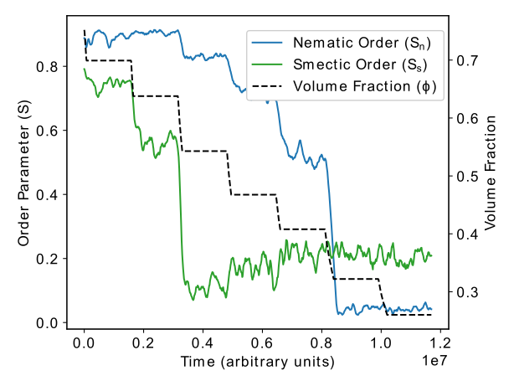
Smectic Phase Transition
Figure 6: The evolution of the volume fraction (φ) against both the nematic (S_{n}) and smectic (S_{s}) order parameters over the timescale of the simulation

Slide 13
Nunchuck Simulations
Introduction
Methods
Rigid Rod Simulations
Nunchuck Simulations
Fixed Rigidity
Fixed Angle
Dynamic Properties
Conclusions

Slide 14
Conclusions
Introduction
Methods
Rigid Rod Simulations
Nunchuck Simulations
Conclusions
Primary Findings
Further Work

Slide 15
References
¹ T. Kato, Y. Hirai, S. Nakaso, and M. Moriyama, Liquid-Crystalline Physical Gels, Chem. Soc. Rev. 36, 1857 (2007).

